Slide 1

Paradigms of pattern recognition
Dr. Umarani Jayaraman
Assistant Professor

Slide 2
Different Paradigms(Models) for Pattern Recognition
1. Statistical Pattern Recognition
2. Syntactic Pattern Recognition/Structural Pattern Recognition
3. Template Matching
4. Neural Networks

Slide 3
1. Statistical Pattern Recognition
Statistical PR is more popular and has received the majority of attention in literature.
The main reason for this is that most practical problems in this area deals with noisy data and uncertainty.
Statistics and probability are good tools to deal with such problems.
In statistical PR, we focus on the statistical properties of the pattern (generally expressed in probability densities) and this will be used in most of the real time applications.
Here, we use vector spaces to represent patterns and classes.

Slide 4
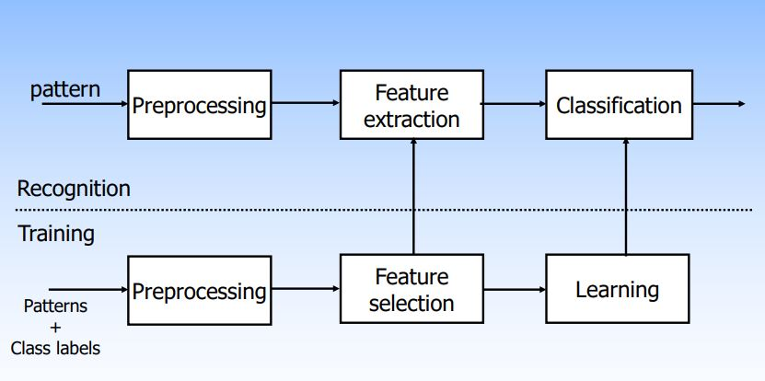
Schematic Diagram :Statistical PR
Supervised Learning

Slide 5
Statistical PR
The abstractions typically deal with probability density or distributions of points in multi dimensional spaces.
Because of the vector space representation, it is meaningful to talk of sub-spaces/projections and similarity between points in terms of distance measures.
There are several soft computing tools associated with this notion.

Slide 6
Soft Computing*
Soft computing, as opposed to traditional computing, deals with approximate models and gives solutions to complex real-life problems.
Soft computing is tolerant of imprecision, uncertainty, partial truth, and approximations. In effect, the role model for soft computing is the human mind.
Soft computing is based on techniques such as fuzzy logic, genetic algorithms, artificial neural networks, machine learning, and expert systems.

Slide 7
Statistical PR-Soft Computing Tools
The Baye’s Classifier characterises optimality in terms of minimum error rate classification.
The use of Hidden Markov Model (HMM) is popular in fields like speech recognition.
Fuzzy set and rough set based pattern recognition schemes employ vector representation of patterns and classes.

Slide 8
Statistical PR-Soft Computing Tools
A decision tree is a transparent data structure which can deal with classification of patterns employing both numerical and categorical features.
Nearest Neighbour Rule: It is the most popular and simple classifier. A new pattern is classified based on the class label of its nearest neighbour. In such a classification, we do not have a training phase.

Slide 9
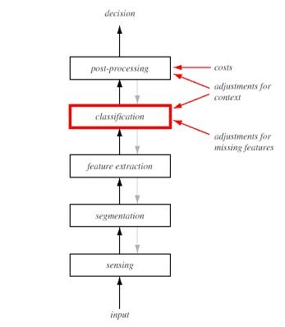
PR System :Schematic Diagram

Slide 10
PR System
Sensor converts images/sounds/physical inputs into signal data.
Segmentation isolates sensed object from the background.
Feature extraction measures object properties that are useful for classification.
Classification assigns sensed object to a category.
Post processing take into account other considerations, such as effects of context and the cost of errors to decide on the appropriate action.

Slide 11
2. Syntactic Pattern Recognition/Structural Pattern Recognition
If the model consists of some set of crisp logical rules, then we employ the method of syntactic pattern recognition, where the rules or grammar describe our decision.
Example: To classify an English sentence as grammatically correct or not, crisp rules are appropriate rather than statistical descriptions such as word frequencies or correlations.

Slide 12
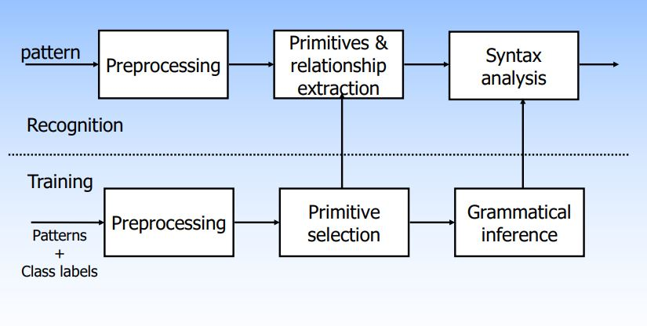
Schematic Diagram : Syntactic PR

Slide 13
3. Template Matching
Template Matching is a method for searching and finding the location of a template image in a larger image.

Slide 14
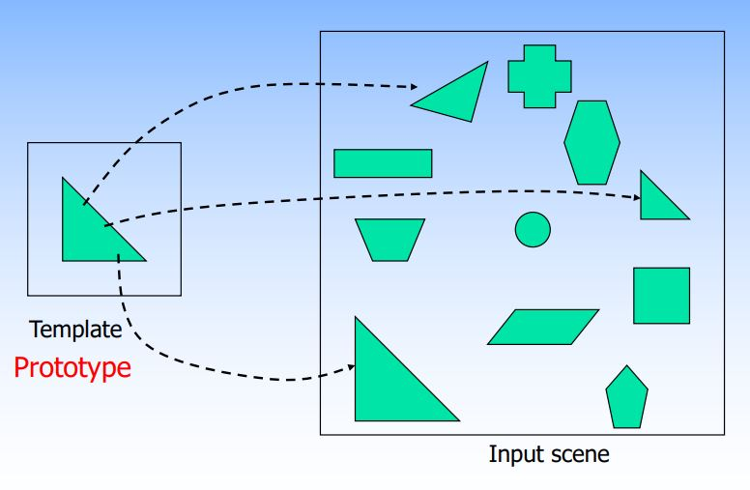
3. Rigid Template Matching

Slide 15
3. Template Matching- Applications
Template matching has various applications and is used in such fields as face recognition and medical image processing.
Systems have been developed and used in the past to count the number of faces

Slide 16
Neural Networks
It is a computational model which tries to approximate the biological neural networks in the human brain
Biological neural networks consists of number of cells (neurons). A neuron consists of dendrites, cell body and axon

Slide 17
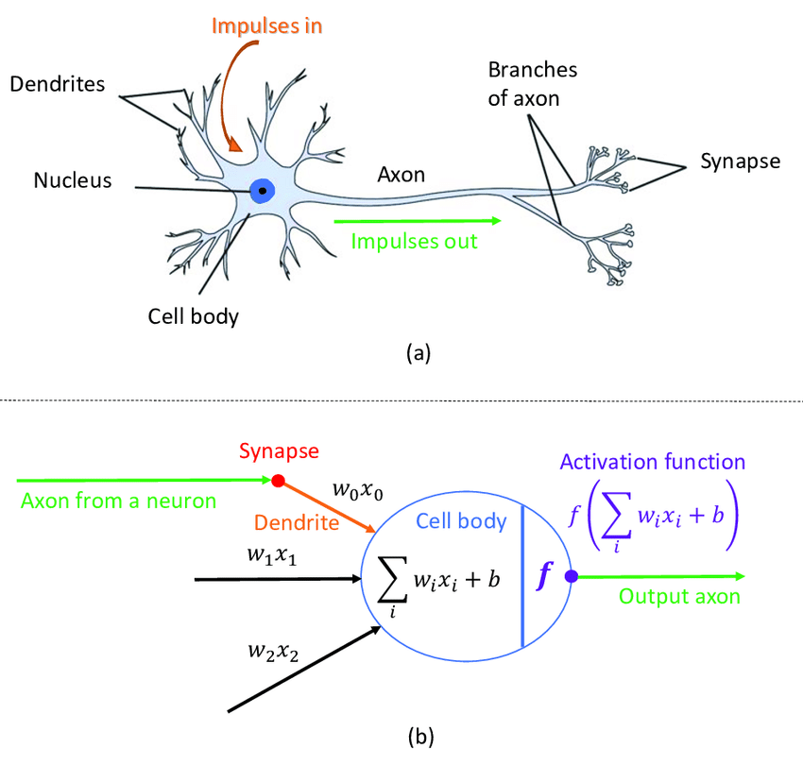
Neural networks

Slide 18
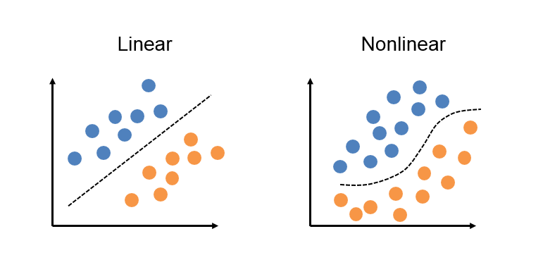
Linear and non-linear classifier
Linear Classifiers- It separates by linear equation
Non linear cases it minimize sum of squared error.

Slide 19
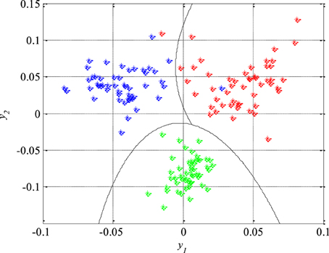
Non linear classifier
The most non linear classifiers are
Quadratic classifier
Cubic classifier

Slide 20
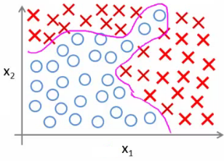
Complex nonlinear decision boundary
The decision boundary is so complicated and it becomes much more complicated if the number of classes becomes more than two
The kind of approach, that people take in such complicated cases is to make use of neural networks

Slide 21
Complex nonlinear decision boundary(3)
Collection of such straight lines actually model such complicated non-linear decision boundary

Slide 22
Complex nonlinear decision boundary(3)
Collection of such straight lines actually model such complicated non-linear decision boundary

Slide 23
Complex nonlinear decision boundary(3)
Collection of such straight lines actually model such complicated non-linear decision boundary

Slide 24
Complex nonlinear decision boundary(3)
Collection of such straight lines actually model such complicated non-linear decision boundary

Slide 25
Complex nonlinear decision boundary(3)
Collection of such straight lines actually model such complicated non-linear decision boundary

Slide 26
Complex nonlinear decision boundary(3)
Collection of such straight lines actually model such complicated non-linear decision boundary

Slide 27
Complex nonlinear decision boundary(3)
Collection of such straight lines actually model such complicated non-linear decision boundary

Slide 28
Complex nonlinear decision boundary(3)
Collection of such straight lines actually model such complicated non-linear decision boundary

Slide 29
Complex nonlinear decision boundary(2)
Though it is a complicated non linear decision boundary we can have a piece wise linear approximation of straight line as below
A neural network in the simplest form actually tries to form a collection of such straight line boundaries

Slide 30
Complex nonlinear decision boundary(3)
Collection of such straight lines actually model such complicated non-linear decision boundary

Slide 31
What does neural networks have?
Output layers
None or more no of hidden layers
Input layer

Slide 32

What does neural networks have?
O_{j}=f(Σ$wijxi$)
o_{j}
w_{ij}
x_{i}

Slide 33
Summary
1. Statistical Pattern Recognition
2. Syntactic Pattern Recognition/Structural Pattern Recognition
3. Template Matching
4. Neural Networks

Slide 34
Thank you

